Slide 1
January 20, 2014

Slide 2
Quote of the month:
“… continue to find new ways to be creative in sparking interest in Scouting – whether you are reaching out to a neighborhood unfamiliar with Scouting or expanding current units.”
Wayne Brock
Chief Scout Executive
Notes:
Referring to a story on urban scouting…
He went on to say… I can tell you from my experience that the journey is not only exciting, but also extremely rewarding.

Slide 3
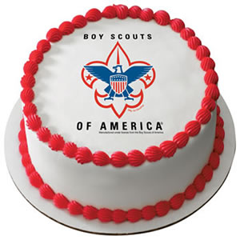
105 Years More than 110 Million Youth
February 8, 2015

Slide 4
SPECIAL GUEST
4

Slide 5
COMMISSIONER Training Updates
Jack Boyde
Assistant Council Commissioner – Training & Recognition

Slide 6
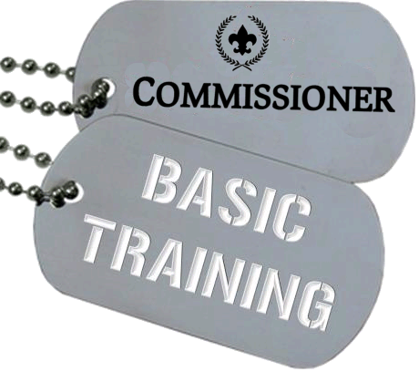
COMMISSIONER Training Updates
February 14 – Area 2 8:30 AM – BC3 Cranberry, PA

Slide 7
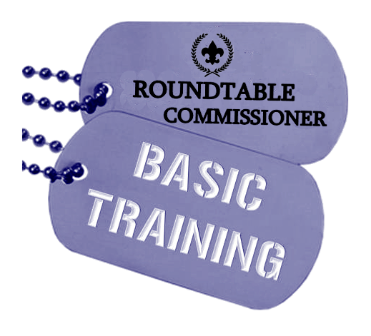
COMMISSIONER Training Updates
February 14 8:30 AM – BC3 Cranberry, PA
INCLUDES COMMISSIONER TOOLS FOR ROUNDTABLES!

Slide 8
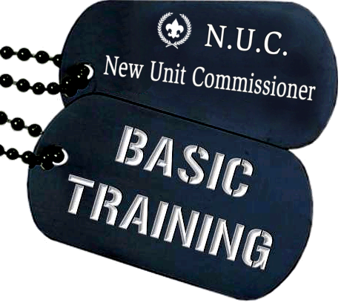
COMMISSIONER Training Updates
April 11 – Location TBD

Slide 9
COMMISSIONER Training Updates
March 14, 2015

Slide 10
Commissioner Conference
June 14 Camp Guyasuta

Slide 11
COMMISSIONER General Updates

Slide 12
Journey to Excellence

Slide 13
UVTS 2014
110 Commissioners entered visits
57 Commissioners entered 5 visits or less
17 Commissioners were DC’s
1621 Total visits
633 Visits were entered by DC’s (39%)

Slide 14
UVTS 2014
304 Leader Meetings
358 Unit Activities
426 Other
533 Unit Meetings
27 Venturing Crews
697 Cub Scout Packs
897 Boy Scout Troops

Slide 15
UVTS 2014
Out of 738 Units…
349 received at least one visit
(47%)
103 met JTE standard 6+ visits
(14%)

Slide 16
#1 Proirity
87 Goal
32 Actual
205 Year-end Total
2.82 Ratio – traditional
3.24 Ratio – including non-trad.

Slide 17
Looking Ahead
Age Changes
18 but not yet 21
Adult standards
March 1
17

Slide 18
Looking Ahead
Cub Scout Changes!
June 1 Launch!
Roundtable Updates
March 14 Training
18
Notes:
What are the 12 Core Values

Slide 19
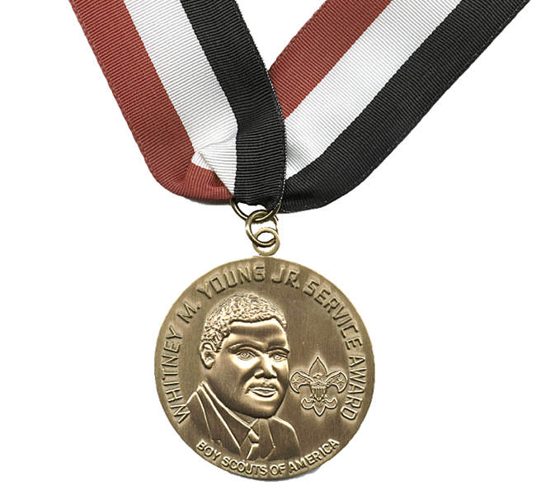
Whitney M. Young, Jr.
Service Award
Vernon J. Smith
2015 HONOREE
February 19 @ Westin

Slide 20
Career Enhancement
What are the seven keys (R’s) to recruiting volunteers?
RECRUIT the volunteers you need.
RETAIN the volunteers you have.
RECLAIM volunteers who leave Scouting.
REFER volunteers who move.
RECOGNIZE the volunteers you have.
REFUSE/REJECT volunteers who aren’t suitable.
ROTATE volunteers who need a change.
Council Commissioner Basic Training
Notes:
Remember: recruiting isn’t the exclusive responsibility of the council commissioner. In fact, as already discussed, a council commissioner’s role in recruiting is limited. But it’s essential that a council commissioner understand the key elements of recruiting and to ensure that others involved understand – and apply – them, too.
There are seven keys to recruiting volunteers;
RECRUIT the volunteers you need:
- get everyone involved
- know the job – find the man or woman to fill it,
- get a short term commitment initially which may lead to long term
involvement.
RETAIN the volunteers you have:
- with appealing, active programs,
- with lots of fun and involvement
with volunteer satisfaction
remember that recognition is a key element of retention.
RECLAIM volunteers who leave Scouting:
- by finding out and correcting the causes for leaving,
- by effective follow up on the transfer system,
by reclaiming volunteers personally.
REFER the volunteers who move:
through friends – pass their names along to the proper person to
follow up,
- by looking wide – keeping your eyes/ears open and advising your
local Scout office
RECOGNIZE the volunteers you have:
- “pat on the back” from a status person for a job well done.
- prompt issuance of awards and certificates,
personal face-to-face contact as often as possible,
REFUSE/REJECT volunteers who are not suitable:
- screen all offers of service carefully,
follow up to appropriate level if a volunteer has to be rejected.
ROTATE volunteers who need a change:
- allow people to follow their own interests,
- watch for volunteers who need and could serve better in a more
challenging job,
- be firm in relocating volunteers who would be more effective in other
positions.

